Slide 1



DATA STRUCTURE AND ANALYSIS
TOPIC : Insertion Sort on Linked List (Decrease-and-Conquer)
JAYANESHAN K S- 24ITR052
1

Slide 2
PROBLEM STATEMENT
Sorting is a fundamental operation in data structures.
In linked lists, efficient sorting is important due to sequential access.
You are given a singly linked list.
Task:
➢ Sort the linked list using Insertion Sort technique
➢ Maintain sorted order during insertion
➢ Analyze efficiency compared to array-based sorting
2

Slide 3
OBJECTIVE
➢ Implement insertion sort for linked list
➢ Apply Decrease-and-Conquer strategy
➢ Compare performance with array insertion sort
➢ Understand pointer manipulation instead of shifting elements
3

Slide 4
ALGORITHM DESIGN TECHNIQUE
Input: Head of linked list
Create a dummy node (sorted list)
Traverse original list node by node
For each node:
Find correct position in sorted list
Insert node in that position
Move to next node
Return sorted list
Logic:
Build sorted list gradually
Insert each element in correct place
4

Slide 5
CODING
// Save next node
ListNode nextTemp = curr.next;
// Insert current node
curr.next = prev.next;
prev.next = curr;
// Move to next node
curr = nextTemp;
}
return dummy.next;
}
// Helper function to print list
public static void printList(ListNode head) {
while (head != null) {
System.out.print(head.val + " -> ");
head = head.next;
}
System.out.println("null");
}
public static void main(String[] args) {
// Example: 4 -> 2 -> 1 -> 3
ListNode head = new ListNode(4);
head.next = new ListNode(2);
head.next.next = new ListNode(1);
head.next.next.next = new ListNode(3);
head = insertionSortList(head);
printList(head); // Output: 1 -> 2 -> 3 -> 4 -> null
}
}
class ListNode {
int val;
ListNode next;
ListNode(int val) {
this.val = val;
this.next = null;
}
}
public class Main {
public static ListNode insertionSortList(ListNode head) {
if (head == null) return null;
// Dummy node to simplify insertion
ListNode dummy = new ListNode(0);
ListNode curr = head;
while (curr != null) {
ListNode prev = dummy;
// Find correct position in sorted part
while (prev.next != null && prev.next.val < curr.val) {
prev = prev.next;
}
6

Slide 6
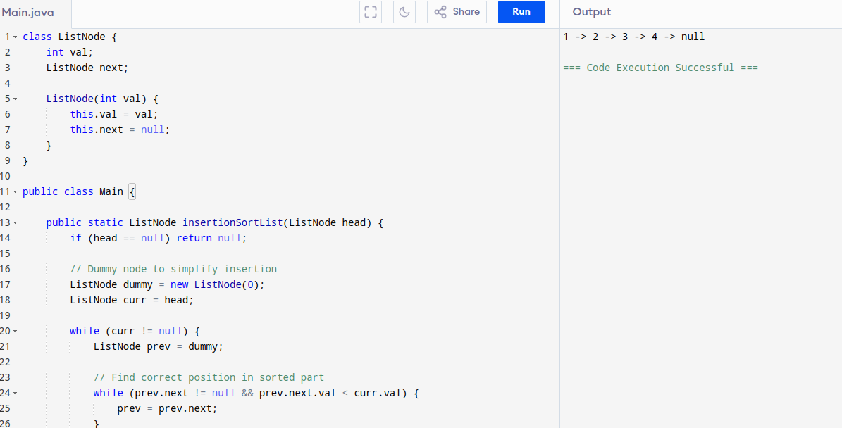
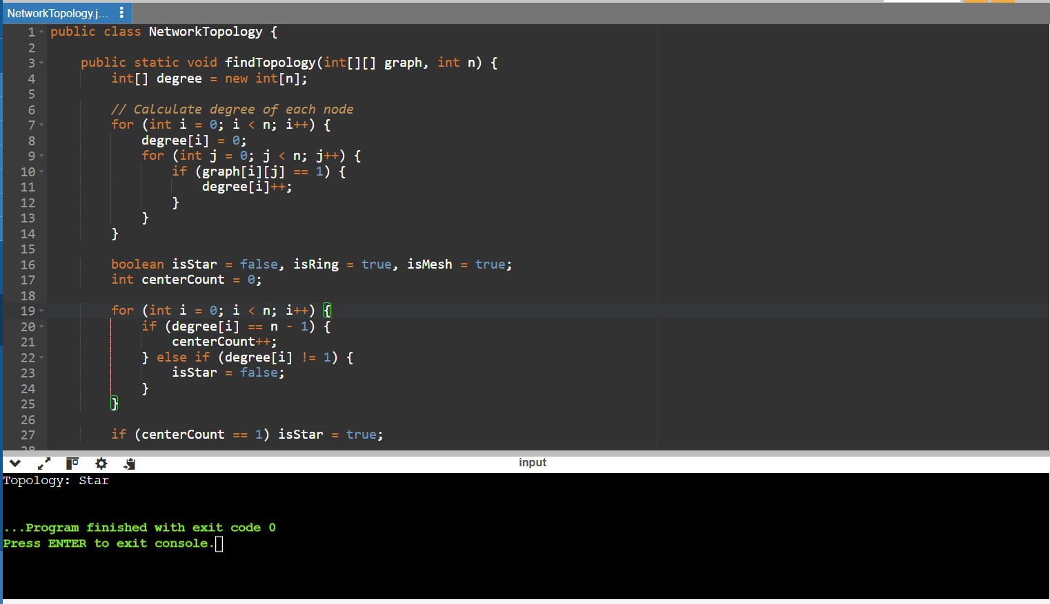
CODING OUTPUT

Slide 7
TIME COMPLEXITY DERIVATION
Let n = number of nodes
➢ For each node, we may traverse the sorted list
➢ Inner traversal → up to n steps
Total operations:
T(n) = n × n
Final Complexity:
➢ Time Complexity: O(n²)
➢ Space Complexity: O(1)

Slide 8
CONCLUSION
➢ Insertion sort works efficiently for linked lists
➢ No shifting required (only pointer changes)
➢ Follows Decrease-and-Conquer approach
➢ Suitable for small datasets
Advantages:
Better memory usage
Easy implementation
Efficient insertion operations

Slide 9
THANK YOU

